Slide 1
Meetings and Documentation
Dr. Geeta Ajit

Slide 2
Meeting
A meeting is a coming together of a number of persons at a certain time and place for discussion.
It can be defined as “a gathering together of two or more persons in order to discuss matters of common concern, in order to arrive at a decision or promulgate a policy.”
“Organisational meetings” are meetings of persons for purpose of exchanging information, making decisions, negotiating, co-ordinating processes and seeking advice with respect to the activities or a business organisation.

Slide 3
Meeting
Official business meetings have three requirements :
They should be called by an authorised person by giving a proper notice
There should be a quorum, a chairman and a secretary to take notes
They should be conducted properly, according to the rules or bye-laws of the organisation.

Slide 4
Advantages of meetings
Meetings serve a variety of purposes:
They foster team spirit.
They help to solve problems by using the skills of the members in terms of analysis, imagination, judgement
They encourage a healthy exchange of ideas and views in dealing with difficult situations, clients and customers.

Slide 5
Role of a chairman
If a meeting is to arrive at any fruitful conclusion it is very necessary that it should be properly “chaired”.
One of the reasons why so many meetings are futile and a waste of time is that the chairman is chosen on account of his position of seniority and not on account of his ability.
Chairmanship is an art and as an art, it can be improved and developed by training and practice.

Slide 6
Role of a chairman
The chairman has to guide the discussion and not allow it to become confused by side-issues and random talk.
The chairman must provide drive and purpose so that the members present feel that some headway is being made.
He should make remarks such as, “ We have now settled this point, let us turn to the next item”, or “ We have still two more decisions to make.”
He should know how motions and resolutions are to be introduced and passed at meetings, how amendments are to be taken up first, and how to deal with points of order that might be raised by members who perceive an irregularity.

Slide 7
DO’s and DON’Ts of Meetings
Do find out what the meeting or conference is all about and prepare for it by studying documents and collecting information.
Arrive in time. Start and end on time.
Establish objectives and be interested in helping the meeting to make progress.
Set an agenda and stick to it.
Be prepared to put your point of view clearly and vigorously but also to listen to others.
Keep an open mind. Be prepared to be convinced by the sound reasoning and good arguments of other speakers.
Always respect the authority.

Slide 8
DOs and DON’Ts of Meetings
8. Don’t interrupt others
9. Don’t dominate the discussion
10. Don’t digress or stray from the subject
11. Don’t have side conversation
12. Be prepared to carry out the decisions of the meetings or conference.
13. Call a meeting only if consultations on telephone do not yield the necessary result.
14. Circulate the notice and agenda well in advance.
15. Prepare the agenda breaking issues into their smallest components.

Slide 9
Notice
A notice is a written intimation of the date, time, place and the business to be transacted at the meeting to all persons who are entitled to get it.
It is sent by the secretary of the association or company and it can be posted or inserted in the newspaper in the form of an advertisement.
It is to be sent a certain number of days before it is held, very often at least two weeks in advance.
In case of company meetings, the usual prescribed period is 21 days.

Slide 10
Notice
The contents of the notice are as follows:
Type of meeting i.e. annual general, statutory or extraordinary general meeting, or meeting of the board of directors or managing committee.
The date, time and place of the meeting.
Business to be transacted at the meeting.
A brief agenda.
Specific resolution if received by the secretary from members
Other announcements, explanatory statements, etc.

Slide 11
Specimen Notice
Members of the youth welfare club are hereby informed that the Annual General Body Meeting of the club will be held at Tarabai Hall on 20 June 2014 at 5 p.m. All members are requested to attend.
Notice is hereby given that the 10th Annual General Meeting of the Allied Cement Company will be held on Saturday, 3October, 2014 at 4 p.m. at the Town Hall, Churchgate, Mumbai.

Slide 12
Notice – Letter Form
RONEO VICKERS LTD
36, Sundernagar
New Delhi
4 August 2014
Mr. B. K. Lohia
59, Nariman Bhuvan
Mumbai – 21
Dear Sir,
This is to inform you that a meeting of the Board of Directors of the company will be held in the
Board Room of the Registered Office of the company on the 1st of September 2014, at 10:45 a.m. where
you are requested to be present. The Agenda for the meeting is enclosed.
Yours faithfully,
Mani Shankar
Secretary
Encl: as above

Slide 13
Agenda
An Agenda is a list of items to be discussed at the meeting
The items should be arranged in a logical order and should be within the scope or the business to be transacted at the meeting.
The Agenda is usually sent to members along with the notice.
The first item in the Agenda is usually reading and approving the minutes of the last meeting.

Slide 14
Specimen Agenda
Agenda
Reading of Minutes of last meeting.
Report of sub-committee to increase membership.
Consider suggestion to collect funds.
Any other business with the permission of the chair.
Vote of thanks to the chairman.

Slide 15
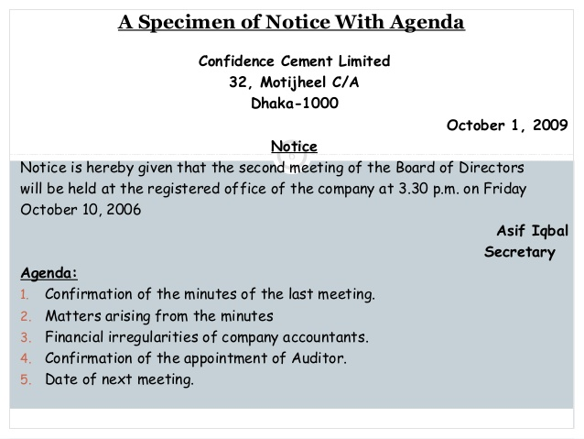

Slide 16
Minutes of a meeting
Definition:
The official written record of a meeting.
Minutes may be kept by any individual in attendance at a meeting and are usually distributed to all members of the unit represented at the meeting.

Slide 17
Meeting Minutes
The Main Parts of Meeting Minutes
Many organizations use a standard template or a special format for keeping minutes, and the order of the parts may vary.
Heading The name of the committee (or other unit) and the date, location, and starting time of the meeting.
Participants The name of the person conducting the meeting along with the names of all those who attended the meeting (including guests) and those who were excused from attending.
Approval of previous minutes A note on whether the minutes of the previous meeting were approved and whether any corrections were made.

Slide 18
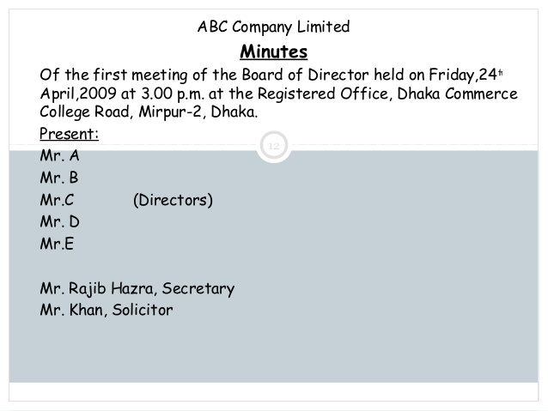

Slide 19
Meeting Minutes
Action items (including unfinished business from the previous meeting) A report on each topic discussed at the meeting. (For each item, note the subject of the discussion, the name of the person who led the discussion, and any decisions that may have been reached.)
Announcements A report on any announcements made by participants, including proposed agenda items for the next meeting.
Next Meeting A note on where and when the next meeting will be held.
Adjournment A note on the time the meeting ended.
Signature line The name of the person who prepared the minutes and the date they were submitted.

Slide 20
Meeting Minutes
In writing minutes, be clear, comprehensive, objective, and diplomatic.
Do not interpret what happened; simply report it. Because meetings rarely follow the agenda perfectly, you might find it challenging to provide an accurate record of the meeting.
If necessary, interrupt the discussion to request clarification. "Do not record emotional exchanges between participants. Because minutes are the official record of the meeting, you want them to reflect positively on the participants and the organization." (Mike Markel, Technical Communication, 9th ed. Bedford/St. Martin's, 2010)

Slide 21
Drafting Resolutions
According to the Companies Act of 1959, resolutions can be of three kinds :
a. Ordinary Resolutions
b. Special Resolutions
C. Resolutions requiring Special Notice
Resolutions are voted upon and passed or rejected by those attending the meeting.
A resolution is proposed by one of the members present, seconded by another member, and then voted upon after discussion.

Slide 22
Drafting Resolutions
A resolution is a formal expression of opinion by a meeting.
It means a firm decision or opinion formally expressed by a group of people, unanimously or by a simple majority.
It is the act of resolving a problem.
A question on which a vote is to be taken is called a “motion”.
A motion begins with the word ‘that’.
The wording of the motion is positive and it must be clear and concise.
When a motion is passed by voting at a meeting, it becomes a resolution.

Slide 23
Drafting Resolutions (cont’d)
An association or company conducts its business by passing resolutions at the meetings.
How effective the wording of a resolution is will determine whether it is clearly understood by the members and the policies implemented.
It is interesting to note that while the minutes of meetings are written generally in the past tense the wordings of resolutions is generally in the present tense.

Slide 24
Wordings of Resolutions
Ways to word the resolution
“It is resolved, on a motion by Shri. Mehta, seconded by Shri Syed, that Shri Pai be appointed Joint-Treasurer of the association for the year 2014-15.”
Resolved that the Association extend its activities to the suburbs of Mumbai, beyond Bandra, and open recreation and welfare centres in at least three places.
Resolved that Mr. Roby Roy who retires by rotation, but being eligible offers himself for re-election, be and is hereby re-elected a Director of the company.

Slide 25
Meeting Minutes
Guidelines for Writing Meeting Minutes
The recorder should be able to write the minutes in near final form as the meeting progresses. . . .
The minutes should focus on results and agreed-on actions. . . .
The minutes should be highly summarized, not a burden to read. Be brief; summarize outcomes and points of agreement and disagreement; don't record detailed input.

Slide 26
Meeting Minutes
Guidelines for Writing Meeting Minutes (con’t)
Avoid writing minutes for the purpose of informing those who were not at the meeting. . . .
Write the minutes soon after the meeting and distribute them promptly (within a day or two). (Murray Hiebert and Bruce Klatt, The Encyclopedia of Leadership: A Practical Guide to Popular Leadership. McGraw-Hill, 2001)

Slide 27
Difference Between Agenda and Minutes
Definition:
Agenda : It is an official list of things to be done or dealt with at particular meeting.
Minutes: The official records of discussion held and decision taken at a meetings are called minutes.
2. Preparation
Agenda : It is drawn up by the secretary in consultation with the chairman.
Minutes: It is generally written by the secretary of the organizational unit.

Slide 28
Difference Between Agenda and Minutes
3. Purpose:
Agenda : Gives the members an idea about the topics to be discussed.
Minutes : Preservation of the resolution of the meetings for future reference.
4. Read Out:
Agenda : It is read out at the beginning of the meeting.
Minutes: It is read out at the next meeting, generally at the beginning, for approval.

